Slide 1

TEAM : HEXAGON
GenMap
Procedural Game Level Generation Engine — deterministic, engine-agnostic, real-time

Slide 2

The Problem with Manual Level Design
⏳ Time Sink
💾 Storage Bloat
Artists spend hours manually placing tiles and sculpting terrain
Static pre-rendered maps inflate installation footprints
🔗 Engine Lock-in
Procedural scripts tied to proprietary APIs, blocking reuse

Slide 3
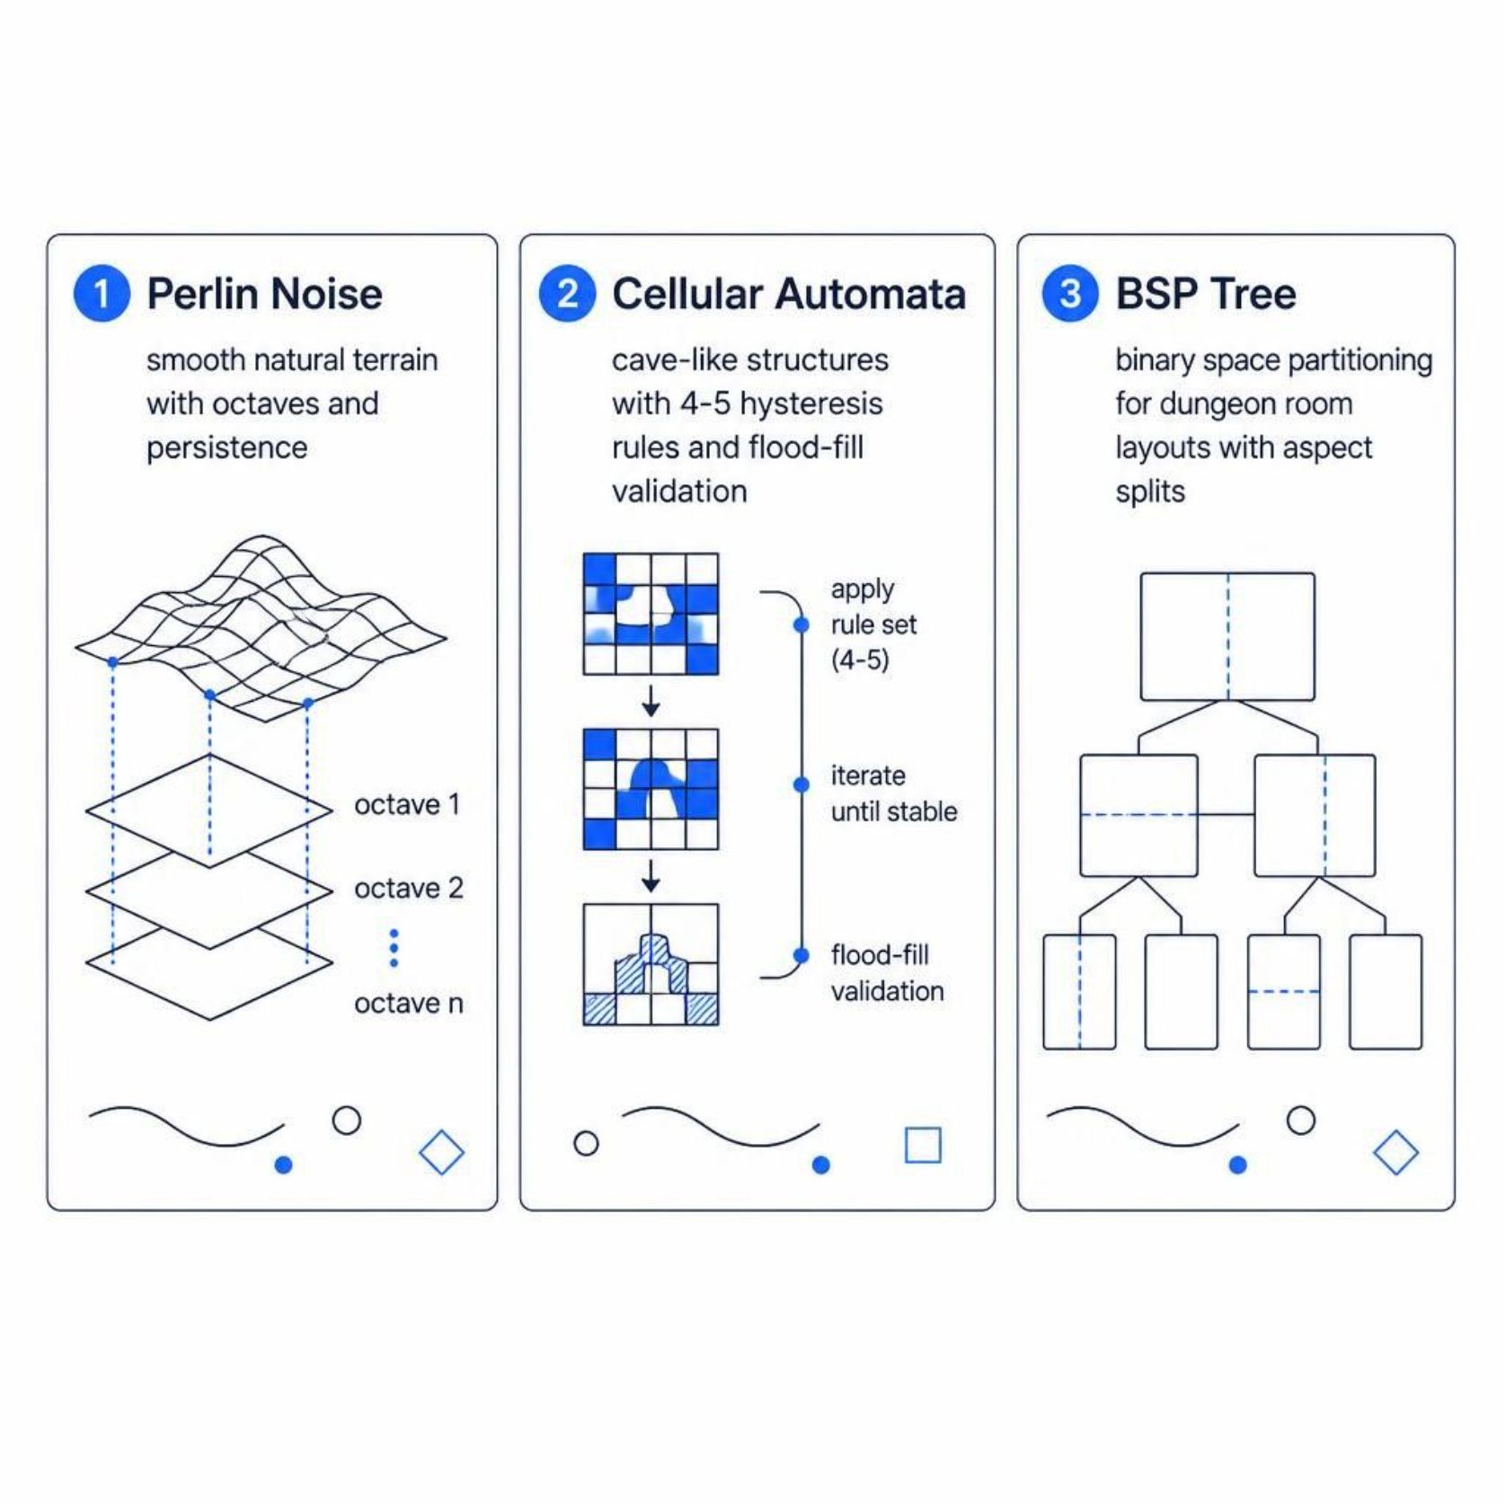
Three Algorithms, One Engine
Core Design Principles
Sub-5ms generation for up to 4K tile grids
O(1) cell lookups via 1D flattened NumPy buffers
Deterministic seed reproducibility across all map types
Engine-agnostic — pure Python, no game engine dependencies

Slide 4
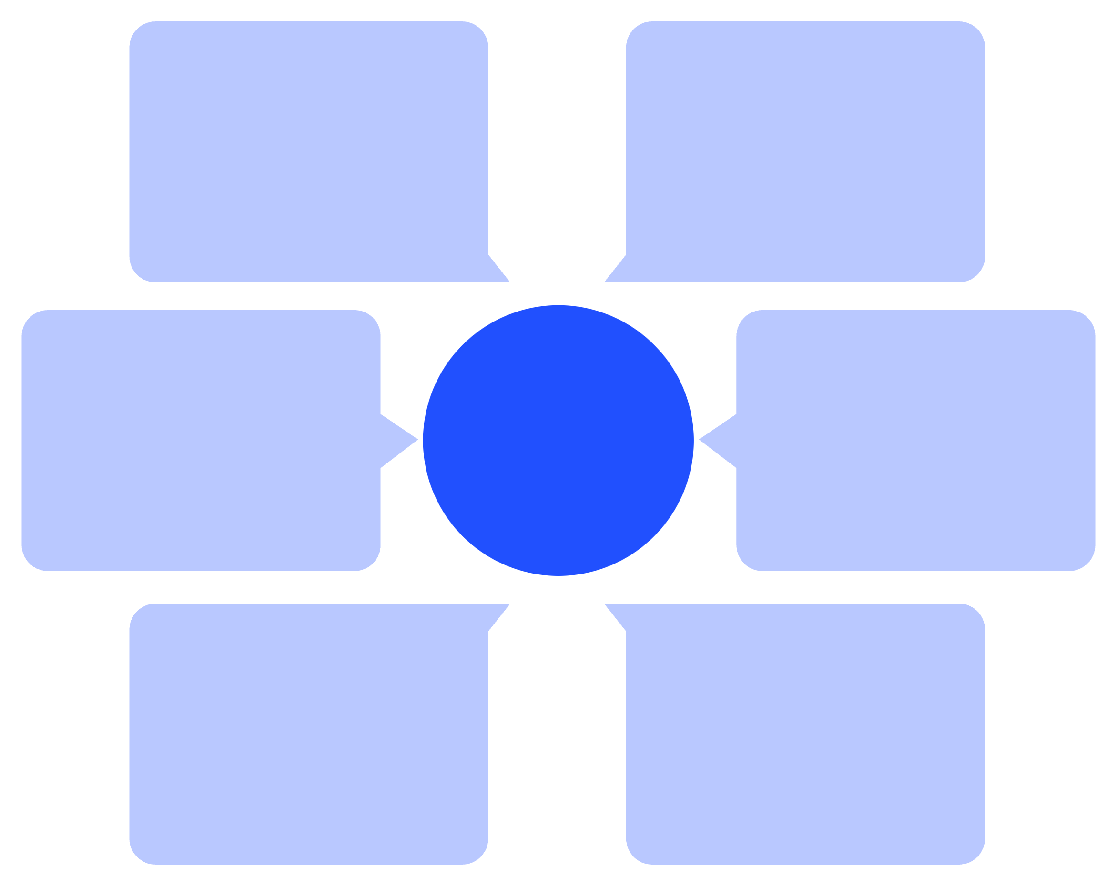
Three-Tier System Architecture
JSON Serializer
Client / Browser
Return tilemap JSON to Canvas display
POST /api/generate with seed, algorithm, dimensions
Pillow PNG Renderer
Flask REST API
Three-Tier Data Flow
Validate request and route to Procedural Core
Render tilemap to PNG image
1D Array Buffer
Procedural Core
Process map data for output
Perlin, Cellular Automata, BSP generation
Decoupled design: mathematical generation, API orchestration, and visual presentation operate independently — enabling headless servers, web backends, and game engine clients alike.

Slide 5
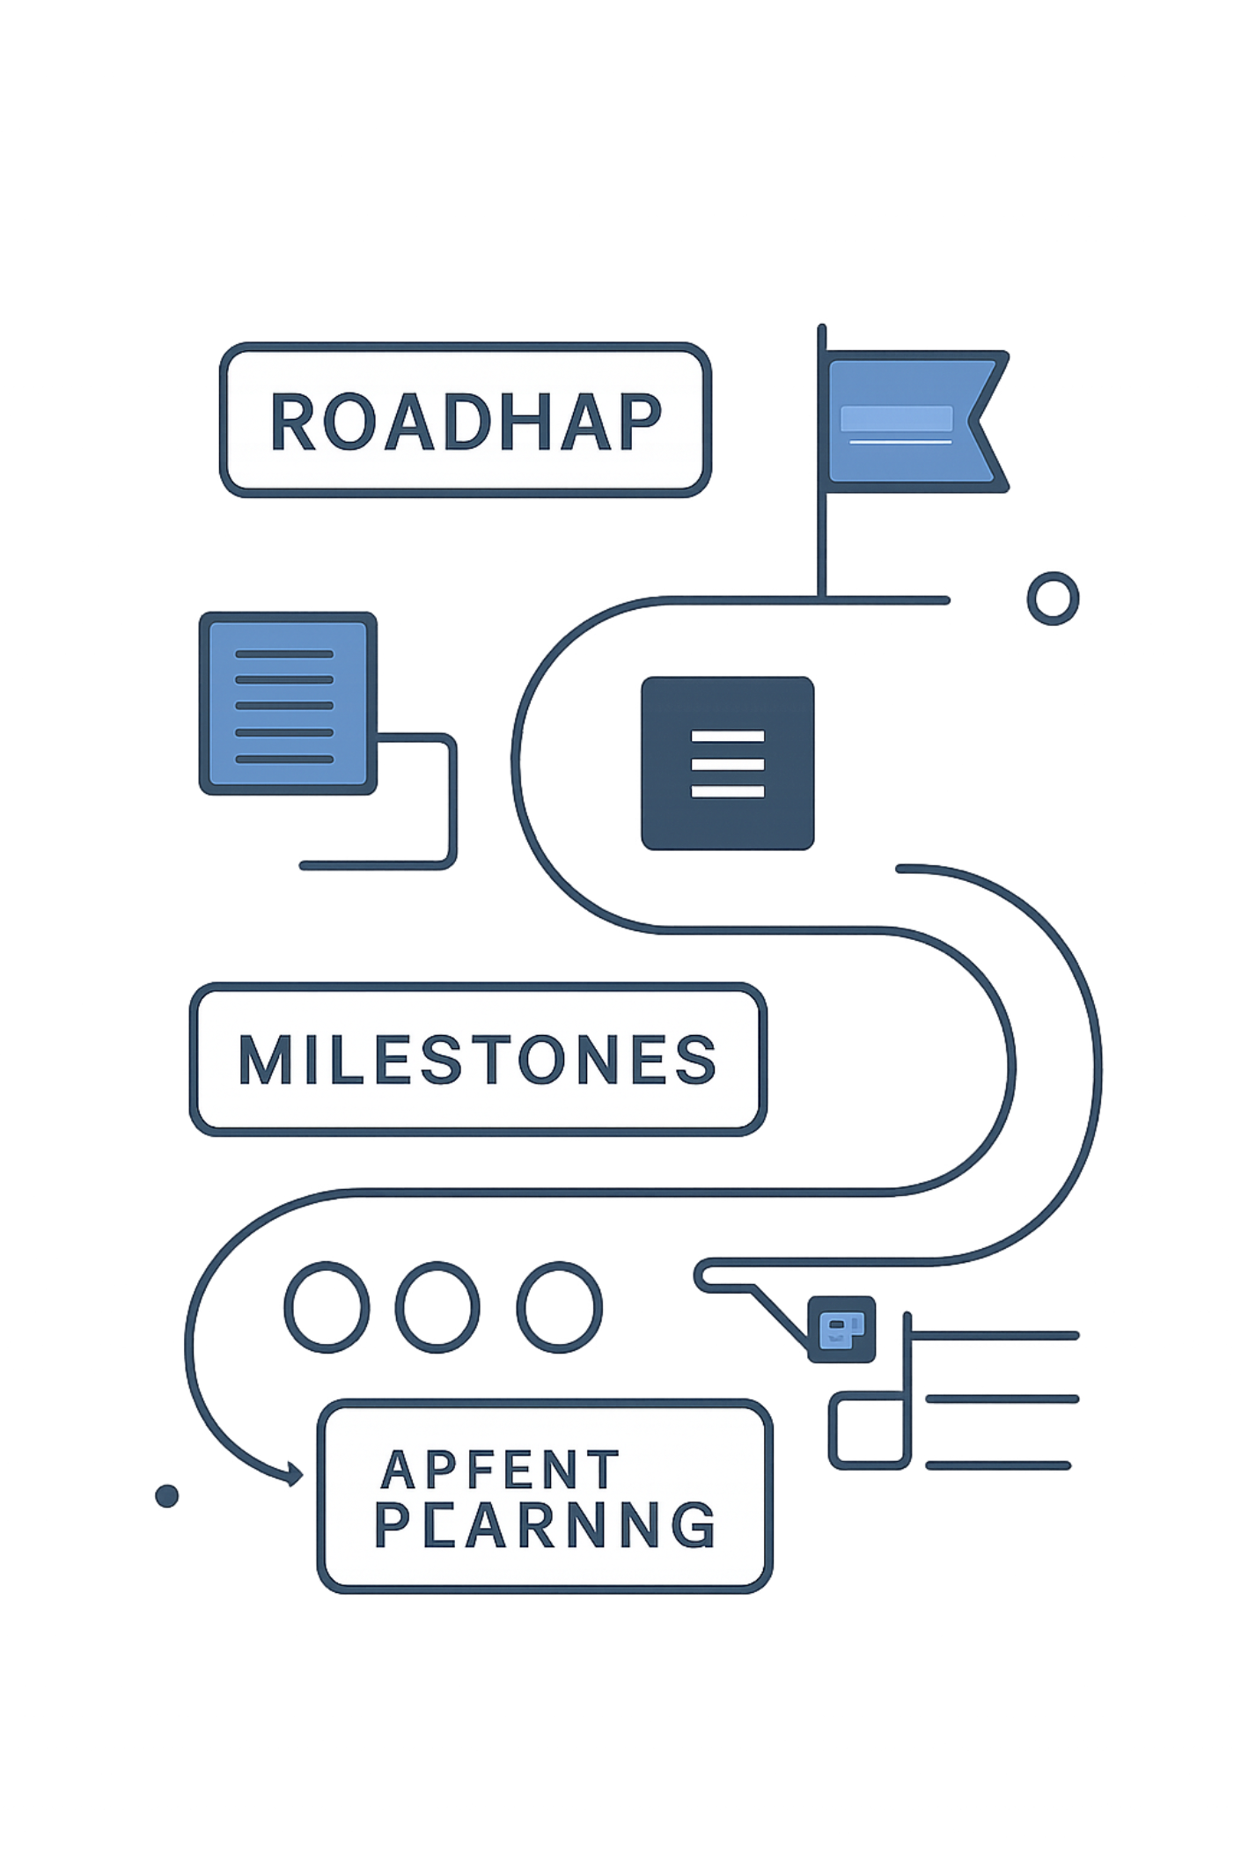
Project Milestones
1
Milestone 1
Core Algorithm Suite — Perlin, Cellular Automata, BSP
2
Milestone 2
Memory & Serialization — 1D buffer, Pillow PNG, JSON export
3
Milestone 3
Backend API & Web Visualizer — Flask REST, HTML5 Canvas
4
Milestone 4
Testing & Docs — pytest, CI pipelines, full documentation

Slide 6






Team Hexagon Avengers
Manish Kanyal
Aman Singh
Mehak Rawat
Shivansh Kala
Team Lead · 2519412
2519290
2519101
2518648
Sagar Singh Rawat
Priyanshu Bisht
2518603
2518552

